Slide 2
State management
State can be stored using several approaches. Each approach is described later in this topic.
STATE MANAGEMENT
Storage approach | Storage mechanism
Cookies | HTTP cookies. May include data stored using server-side app code.
Session state | HTTP cookies and server-side app code
TempData | HTTP cookies or session state
Query strings | HTTP query strings
Hidden fields | HTTP form fields
HttpContext.Items | Server-side app code
Cache | Server-side app code

Slide 3
Session state
Session state is an ASP.NET Core scenario for storage of user data while the user browses a web app.
Session state uses a store maintained by the app to persist data across requests from a client.
The session data is backed by a cache and considered ephemeral data.
The site should continue to function without the session data.
Critical application data should be stored in the user database and cached in session only as a performance optimization.
ASP.NET Core maintains session state by providing a cookie to the client that contains a session ID. The cookie session ID:
Is sent to the app with each request.
Is used by the app to fetch the session data.

Slide 4
Session is per user global variable
Ie. Once data is stored in Session it can be read in any page of that web site.
It is user specific and browser specific
Login Page
Product Page
Cart Page

Slide 5
Points to remember about session state variables:
Session state variables are stored on the web server by default, and are kept for the life time of a session.
2. The default session state mode is InProc.
3. The life time of a session is determined by the timeout value in startup file. The default is 20 minutes. The time-out value can be adjusted according, to your application requirements.
4. Session state variables are available across all pages, but only for a given single session. Session variables are like single-user global data.
5. It is always a good practice to check, if a session state variable is null before calling any of its methods, such as ToString(). Otherwise, we may run into runtime NullReferenceExceptions.
if (Session["Name"] != null)
6. Application performance can be improved by disabling session state, if it's not required. Session state can be turned off at the page or application level.

Slide 6
Session state exhibits the following behaviors:
The session cookie is specific to the browser.
Sessions aren't shared across browsers.
Session cookies are deleted when the browser session ends.
If a cookie is received for an expired session, a new session is created that uses the same session cookie.
Empty sessions aren't retained.
The session must have at least one value set to persist the session across requests.
When a session isn't retained, a new session ID is generated for each new request.
The app retains a session for a limited time after the last request.
The app either sets the session timeout or uses the default value of 20 minutes. Session state is ideal for storing user data:
That's specific to a particular session.
Where the data doesn't require permanent storage across sessions.
Session data is deleted either when the ISession.Clear implementation is called or when the session expires.
There's no default mechanism to inform app code that a client browser has been closed or when the session cookie is deleted or expired on the client.
Session state cookies aren't marked essential by default. Session state isn't functional unless tracking is permitted by the site visitor.

Slide 7
How to set session
public class HomeController : Controller
{
const string SessionName = "_Name";
const string SessionAge = "_Age";
public IActionResult Index()
{
HttpContext.Session.SetString(SessionName, "DAC");
HttpContext.Session.SetInt32(SessionAge, 24);
return View();
}

Slide 8
How to Read Session
public IActionResult About()
{
ViewBag.Name = HttpContext.Session.GetString(SessionName);
ViewBag.Age = HttpContext.Session.GetInt32(SessionAge);
ViewData["Message"] = "Asp.Net Core !!!.";
return View();
}
About View
<h1> Welcome</h1>
@ViewBag.Name
@ ViewBag.Age
@ ViewData["Message"]
Index View
Value set in session
<a asp-action=“About”>Red Session</a>

Slide 9
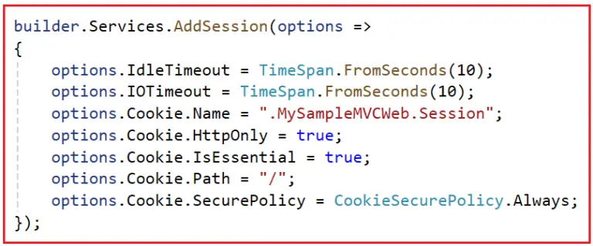
How to configure session
IdleTimeout: options.IdleTimeout = TimeSpan.FromSeconds(10);
It sets the duration for which the session can remain idle (no requests made by the user) before it is abandoned (i.e., removed from the server). If the user does not make a request within this time frame, the session data will be lost. This property is set to TimeSpan.FromSeconds(10), meaning the session will expire if no requests are made within 10 seconds. This is useful for limiting the lifespan of sessions to enhance security and reduce server load.
IOTimeout: options.IOTimeout = TimeSpan.FromSeconds(10);
It sets the maximum time allowed for the session middleware for input/output operations, i.e., to load a session from the store or save it back to the store. If the session data cannot be read from or written to the store within this time frame, an exception is thrown. This is important in scenarios where quick data retrieval is essential for performance. In our example, it’s set to TimeSpan.FromSeconds(10), indicating that I/O operations related to session state (like reading from or writing to session) should be completed within 10 seconds.
Cookie.Name: options.Cookie.Name = “.MySampleMVCWeb.Session”;
It sets the name of the cookie used to store the session ID on the client’s browser. Here, the session cookie is named “.MySampleMVCWeb.Session”. A specific cookie name can help differentiate your session cookies from other applications on the same domain. By default, this cookie is named “.AspNetCore.Session”.
Cookie.HttpOnly: options.Cookie.HttpOnly = true;
It determines if the cookie is accessible only through HTTP (not via client-side scripts like JavaScript). When set to true, this property ensures that the cookie is accessible only to the server side and not available through client-side scripts (e.g., JavaScript). This helps prevent cross-site scripting (XSS) attacks, where unauthorized scripts try to access the cookies.
Cookie.IsEssential: options.Cookie.IsEssential = true;
It indicates whether the cookie is essential for the application to function correctly. When set to true, the essential cookies bypass consent checks under certain privacy regulations like the GDPR. This is useful for cookies that are necessary for user sessions and authentication.
Cookie.Path: options.Cookie.Path = “/”;
It sets the path for which the cookie is valid. By setting the path to /, the cookie is available on all pages of the application. This is the default setting, but you can restrict it to a specific part of the application if needed. For example, options.Cookie.Path = “/Home”; (limits the cookie to the specified path).
builder.Services.AddDistributedMemoryCache(); //default setting
builder.Services.AddSession(options => {
options.IdleTimeout = TimeSpan.FromMinutes(1);//You can set Time
});
//services.AddMvc();
}
Cookie.SecurePolicy: options.Cookie.SecurePolicy =
CookieSecurePolicy. Always;
It determines under what conditions the cookie should be sent over HTTPS. Setting it to Always ensures that the cookie is only sent over HTTPS, providing additional security by preventing the cookie from being transmitted over insecure connections. The options are as follows:
options.Cookie.SecurePolicy = CookieSecurePolicy.Always; (cookie sent only over HTTPS).
options.Cookie.SecurePolicy = CookieSecurePolicy.None; (cookie sent over HTTP or HTTPS).
options.Cookie.SecurePolicy = CookieSecurePolicy.SameAsRequest; (cookie sent using the same protocol as the request).

Slide 10
if (env.IsDevelopment())
{
app.UseDeveloperExceptionPage();
}
else
{
app.UseExceptionHandler("/Error");
// The default HSTS value is 30 days. You may want to change this for production scenarios, see https://aka.ms/aspnetcore-hsts.
app.UseHsts();
}
app.UseHttpsRedirection();
app.UseStaticFiles();
app.UseRouting();
app.UseAuthorization();
app.UseSession();
app.UseEndpoints(endpoints =>
{
endpoints.MapControllerRoute(
name: "default",
pattern: "{controller=Home}/{action=Index}/{id?}");
endpoints.MapRazorPages();
});
}
}

Slide 11
How do you Access the Session Object in a View?
@using Microsoft.AspNetCore.Http;
then you can easily access session variables like that
<h1>@Context.Session.GetString("MySessionValue")</h1>
To use the Session inside a View, we need to inject the IHttpContextAccessor object into our view and then use the IHttpContextAccessor object to get the HttpContext and Session. For this, we need to add the following two statements in our view. The first statement adds the namespace, and the second statement injects the IHttpContextAccessor. Using this HttpContextAccessor, we can access the HttpContext and Session object. @using Microsoft.AspNetCore.Http; @inject IHttpContextAccessor HttpContextAccessor
Do not forget
HttpContextAccessor service within the Program class’s main method.
builder.Services.AddSingleton<IHttpContextAccessor, HttpContextAccessor>();
@using Microsoft.AspNetCore.Http;
@inject IHttpContextAccessor HttpContextAccessor
@{
ViewData["Title"] = "Home Page";
}
<div class="text-left">
<b>User Name:</b> @HttpContextAccessor?.HttpContext?.Session.GetString("_UserName")
<br />
<b>User Id:</b> @HttpContextAccessor?.HttpContext?.Session.GetInt32("_UserId")
</div>

Slide 12
using Microsoft.AspNetCore.Mvc;
using WebAppCookieslogin.Models;
namespace WebAppCookieslogin.Controllers
{
public class SessionController : Controller
{
const string SessionName = "_Name";
const string SessionAge = "_Age";
public IActionResult Index()
{
if (HttpContext.Session.GetString(SessionName) != null)
{
ViewBag.Name = HttpContext.Session.GetString(SessionName);
ViewBag.Age = HttpContext.Session.GetInt32(SessionAge);
ViewData["Message"] = "Asp.Net Core !!!.";
return View();
}
return RedirectToAction("Create");
}
// GET: UserLoginController/Create
public ActionResult Create()
{
return View();
}
// POST: UserLoginController/Create
[HttpPost]
[ValidateAntiForgeryToken]
public ActionResult Create(UserLogin Userdata)
{
try
{
if (ModelState.IsValid)
{
HttpContext.Session.SetString(SessionName, Userdata.Email);
HttpContext.Session.SetInt32(SessionAge,24);
}
return RedirectToAction(nameof(Index));
}
catch
{
return View();
}
}
[HttpPost]
public ActionResult Delete()
{
HttpContext.Session.Remove(SessionName);
return View();
}
}
}
namespace MVCSession_Cookie.Models
{
public class UserLogin
{
public string Email { get; set; }
public string Password { get; set; }
public bool Remember { get; set; }
}
}
When User Logged in
we store Email and age 24
in session
After this user will be sent to index page
Where you have created Delete button
Which will call delete action method
Delete Action method will delete data from session
And display delete view
Observer If user Visit index page we have redirected user to login page

Slide 13
@model WebAppCookieslogin.Models.UserLogin
@{
ViewData["Title"] = "Create";
}
<h1>Create</h1>
<h4>UserLogin</h4>
<hr />
<div class="row">
<div class="col-md-4">
<form asp-action="Create">
<div asp-validation-summary="ModelOnly" class="text-danger"></div>
<div class="form-group">
<label asp-for="Email" class="control-label"></label>
<input asp-for="Email" class="form-control" />
<span asp-validation-for="Email" class="text-danger"></span>
</div>
<div class="form-group">
<label asp-for="Password" class="control-label"></label>
<input asp-for="Password" class="form-control" />
<span asp-validation-for="Password" class="text-danger"></span>
</div>
<div class="form-group form-check">
<label class="form-check-label">
<input class="form-check-input" asp-for="Remember" /> @Html.DisplayNameFor(model => model.Remember)
</label>
</div>
<div class="form-group">
<input type="submit" value="Create" class="btn btn-primary" />
</div>
</form>
</div>
</div>
<div>
<a asp-action="Index">Back to List</a>
</div>
@section Scripts {
@{await Html.RenderPartialAsync("_ValidationScriptsPartial");}
}

Slide 14
@*
For more information on enabling MVC for empty projects, visit https://go.microsoft.com/fwlink/?LinkID=397860
*@
@{
}
<h1>Welcome user you have logged in</h1>
<h2>
@ViewBag.Name
@ViewBag.Age </h2>
@ViewData["Message"]
<div class="col-md-4">
<form asp-action="delete">
<div class="form-group">
<input type="submit" value="Delete" class="btn btn-primary" />
</div>
</form>
</div>

Slide 15
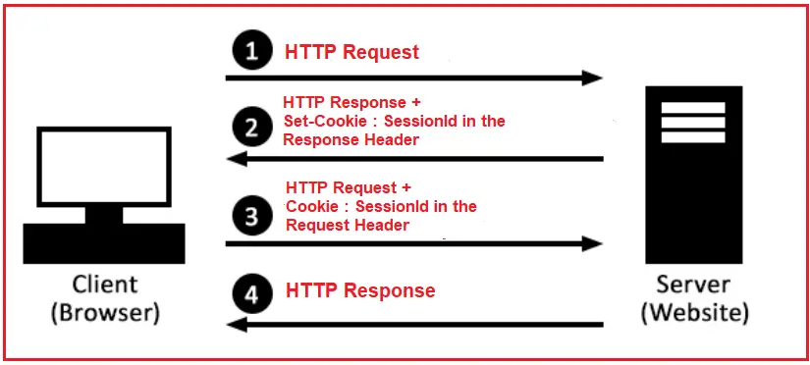
Step 1: Client Makes an Initial Request
When users first visit a web application, they send a request to the server (e.g., by entering a URL into their browser or clicking a link). If the user has no existing session, this is recognized as a new session request.
Step 2: Server Creates a Session
Upon receiving the request, the server checks if an existing session is associated with this client. Since this is the initial request, no session exists. The server creates a unique session identifier (session ID). This Session ID is important as it will track the user’s session across multiple requests.
Step 3: Server Stores Session Data
The session object can store various data, such as user preferences, login status, shopping cart contents, etc., and the session data is stored on the server side in a session store that maps the Session ID. The session store could be in memory, a database, or a distributed cache like Redis. but can be configured based on business requirements.
Step 4: Server Sends Session ID to Client
The server sends the session ID back to the client in the response. This is usually done by setting a cookie in the response header. The cookie contains the session ID and is typically configured with attributes like HttpOnly, Secure, etc.
Step 5: Client Stores the Session ID
The client’s browser stores the session ID cookie under the domain from which it came. This cookie will be sent with every subsequent request to the server, allowing the server to identify the session.
Step 6: Client Makes Subsequent Requests
For every subsequent request made by the user’s browser to the server, the browser sends the cookie containing the Session ID back to the server. This happens automatically with every request to the domain, provided the cookie has not expired or been deleted.
Step 7: Server Retrieves Session Data
With each incoming request that includes a Session ID, the server looks up the session ID in the session store. If the session ID is valid and not expired, the server retrieves the session data associated with that ID.
Step 8: Server Processes the Request
The server processes the request, using the session data as needed. For example, it might use the session data to confirm that the user is logged in or to retrieve items in the user’s shopping cart.
Step 8: Server Updates Session Data (if needed)
The server may update the session data based on the request. For example, if the user adds an item to their shopping cart, the server updates the session data to reflect this change under the user’s Session ID.
Step 9: Server Sends Response
The server sends a response back to the client, including updates to the session ID cookie (e.g., to extend its expiration time).
Step 10: Idle Timeout and Expiration
Sessions typically have an expiration (e.g., 20 minutes of inactivity) or an idle timeout. If the client does not make a request within this period, the session expires and is removed from the session store. On subsequent requests after expiration, the server will create a new session. This is a security measure and a way to free up resources.
Step 11: User Logs Out
If the application involves a user log-in, the user can typically log out. When this happens, the session can be explicitly ended by the server. The server then deletes the session data, and usually, the client is instructed to delete the session cookie.
Step 12: Session End
Whether a session ends due to logout, expiration, or the user’s manual cookie deletion, once the session ends, the server no longer retains the session data. Any subsequent request will be treated as a new session, repeating the process from Step 1.
Note: Each browser has a unique SessionId that is deleted at the end of the session and not shared with other browsers. The default session timeout is 20 minutes

Slide 16
Types of Sessions in Web Applications
There are primarily two types of sessions in web applications:
In-Memory or In-Proc Sessions: Data is stored in memory on the web server. This is fast and suitable for small-scale applications but not suitable for large-scale applications or load-balancing environments.
Distributed or Out-Proc Sessions: Data is stored outside the web server process, often using databases or external caching services like Redis or Memcached. This approach is ideal for load-balanced environments to maintain session data consistency.

Slide 17
In-Memory or In-Proc vs. Distributed or Out-Proc Sessions in ASP.NET Core MVC
In ASP.NET Core MVC, session management can be categorized into two main types: In-Memory (In-Proc) sessions and Distributed (Out-Proc) sessions. Each type has its advantages and use cases depending on the application requirements. Let us understand the differences between these two approaches in detail:
In-Memory (In-Proc) Sessions in ASP.NET Core MVC
In-memory sessions store session data on the web server’s memory (RAM). Data is tied to the application’s process and is lost if the application restarts or crashes. It is suitable for applications running on a single server.
Advantages of In-Memory (In-Proc) Sessions:
In-memory sessions are faster because they are stored directly in the server’s memory, and hence, data access is done from memory.
This approach is easy to set up and doesn’t require additional infrastructure or configuration.
Disadvantages of In-Memory (In-Proc) Sessions:
In-memory sessions are not ideal for load-balanced or multi-server applications that need to scale out across multiple servers because the session data is not shared across the servers.
If the server crashes or restarts, all the session data is lost, which can be problematic for applications that rely heavily on session data.
As the number of users increases, the web server’s memory usage can also increase, which can impact the server’s overall performance.
Distributed (Out-Proc) Sessions in ASP.NET Core MVC
Distributed sessions store session data in an external store such as a database, Redis, or SQL Server. Data is not tied to the application’s process, ensuring persistence across restarts and crashes. It is suitable for applications running in a distributed environment (e.g., cloud, load-balanced setups).
Advantages of Distributed (Out-Proc) Sessions:
Distributed sessions are Ideal for load-balanced, multi-server, and cloud-based applications that require scalability and run across multiple servers. The session data is stored in a centralized location, accessible to all servers.
The session data is preserved even if individual web servers are restarted or the application crashes.
It supports various storage backends, such as SQL Server, Redis, and others, which can be chosen based on the application’s specific needs and existing infrastructure.
It enables sharing session data across different servers.
Disadvantages of Distributed (Out-Proc) Sessions:
Requires additional configuration and infrastructure setup, such as maintaining a Redis cache or SQL database for session storage.
Depending on the storage mechanism and network latency, accessing session data might be slower compared to in-memory sessions.
Using external services (like Redis Cache) or maintaining dedicated infrastructure for session storage can increase costs.
Choosing Between In-Memory and Distributed Sessions in ASP.NET Core MVC
Single Server Environment: Use In-Memory sessions for simplicity and performance.
Load-Balanced or Cloud Environment: Use Distributed sessions for scalability and reliability.
Persistence Requirement: Use Distributed sessions if session data needs to persist across application restarts.
Resource Constraints: Use In-Memory sessions if external dependencies are not feasible.

Slide 18
builder.Services.AddDistributedMemoryCache(); //default setting
Distributed Memory Cache
The Distributed Memory Cache (AddDistributedMemoryCache) is a framework-provided implementation of IDistributedCache that stores items in memory. The Distributed Memory Cache isn't an actual distributed cache. Cached items are stored by the app instance on the server where the app is running.
The Distributed Memory Cache is a useful implementation:
In development and testing scenarios.
When a single server is used in production and memory consumption isn't an issue. Implementing the Distributed Memory Cache abstracts cached data storage. It allows for implementing a true distributed caching solution in the future if multiple nodes or fault tolerance become necessary.
The sample app makes use of the Distributed Memory Cache when the app is run in the Development environment in Program.cs:

Slide 19
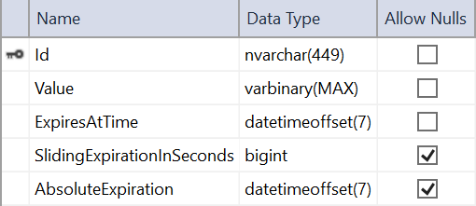
Distributed SQL Server Cache
The Distributed SQL Server Cache implementation (AddDistributedSqlServerCache) allows the distributed cache to use a SQL Server database as its backing store. To create a SQL Server cached item table in a SQL Server instance, you can use the sql-cache tool. The tool creates a table with the name and schema that you specify.
Create a table in SQL Server by running the sql-cache create command. Provide the SQL Server instance (Data Source), database (Initial Catalog), schema (for example, dbo), and table name (for example, TestCache):
dotnet sql-cache create "Data Source=(localdb)/MSSQLLocalDB;Initial Catalog=DistCache;Integrated Security=True;" dbo TestCache
After this command following table get created
builder.Services.AddDistributedSqlServerCache(options => { options.ConnectionString = builder.Configuration.GetConnectionString( "DistCache_ConnectionString");
options.SchemaName = "dbo";
options.TableName = "TestCache"; });

Slide 20
Product1
Product2
Display all product and bill amount
C#-600
C-300
HTML-600
JS-600

